Slide 1
Learn classes with Class {}
Stéphane van gulick
Notes:
This is the slide shown before the presentation starts. When you are ready to go, tell the video operator to start the recording, and click to the next slide.

Slide 2
5
Video operator, did you start the recording?
Notes:
[REQUIRED SLIDE]
These slides are mandatory and help us with video post-processing. Please keep them as they are.

Slide 3
4
Notes:
[REQUIRED SLIDE]

Slide 4
3
Notes:
[REQUIRED SLIDE]

Slide 5
2
Notes:
[REQUIRED SLIDE]

Slide 6
1
Notes:
[REQUIRED SLIDE]

Slide 7
Learn classes with Class {}
Stéphane van gulick
Notes:
This is your opening. Now the stage is yours!

Slide 8
How to insert your Twitter handle
1. On the Insert tab, select Header & Footer.
2. On the Slide tab, check the Footer box.
3. In the box below Footer, type your Twitter handle (e.g. @PSConfEU).
4. To prevent the footer from appearing on the title slide, check the Don't show on title slide box.
5. Click Apply to All button.

Slide 9
This Session
Understand the concepts behind classes
Understand why classes are the next step in the admin / engineer learning process.
Learn how to use classes effeciently using years of best practises.
Learn 'advanced' OOP concepts
Learn how I have implemented classes in real life projects
Notes:
Please invest some time to reconsider your session: what is it that audience can get out of it? Try and be as precise as you can. If you are showing solutions, then focus on “how to”. If you present about a general technology, you’ll want to stick to “Be able to” or “Understand why/how”.

Slide 10
Agenda
Class Basics
What is a class?
OOP Basics
Lessons learned from the field & some best practises
Advanced concepts
UML Diagrams
SOLID principles
TDD
Design Patterns
Next steps
Notes:
Psconf.eu is about demos and code. Try and minimize use of text slides

Slide 11

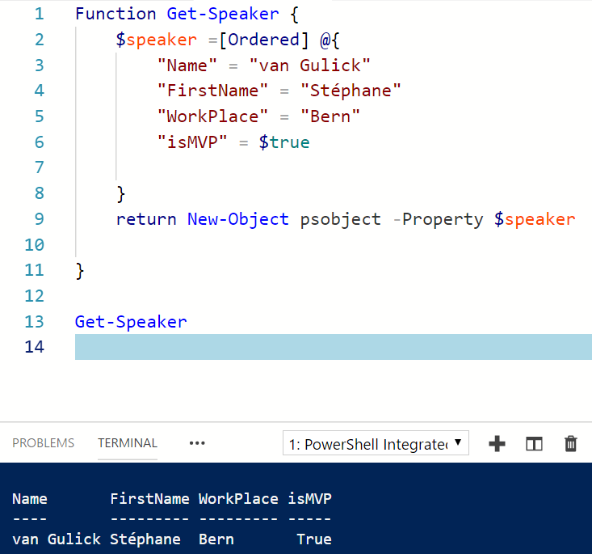


about_Speaker
Notes:
Do not EVER discuss this slide during your presentation. Please do not take presentation time to talk about yourself more than just a few introductory sentences. Instead, invite interested audience to the coffee break, and then talk about yourself, your job, your services, etc.
Use this slide to sum up your details. It will be part of the conference materials and recorded videos.

Slide 12

How to transmit my knowledge?

Slide 13
Session plan
Learning what an object was
Learning class basics
Reusing knowledge
Looking forward
Making mistakes

Slide 14
Learning from the beginning
The struggle
Notes:
Please invest some time to reconsider your session: what is it that audience can get out of it? Try and be as precise as you can. If you are showing solutions, then focus on “how to”. If you present about a general technology, you’ll want to stick to “Be able to” or “Understand why/how”.

Slide 15
Click! (What is an object?)
$Date = Get-Date
$NewTime = $Date.AddDays(5)
$NewTime.Day

Slide 16
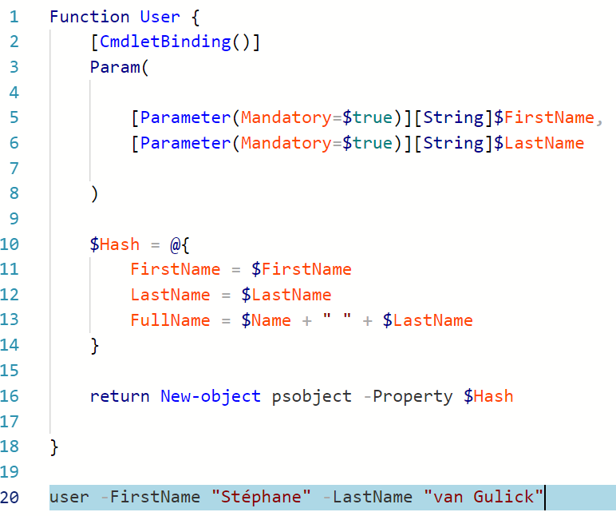
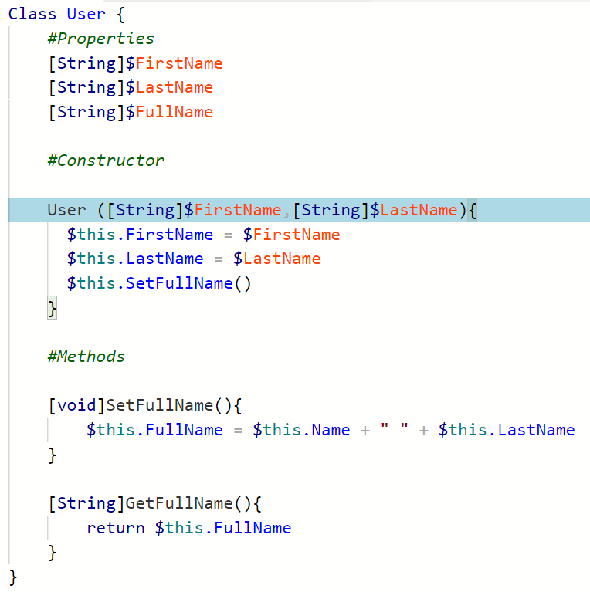
Introduction: assimilating class concepts
Function
Class

Slide 17
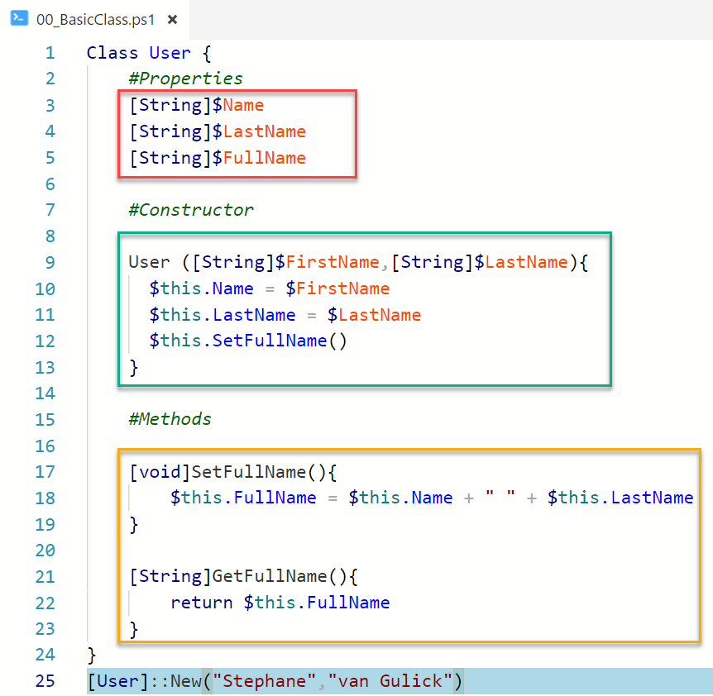
Class basics
Properties:
Holds information on the object
Constructors:
Creates your object
Methods:
Add functionality to your object
Creating an object (Instanciate):
New-Object ClassName
[ClassName]::New()

Slide 18
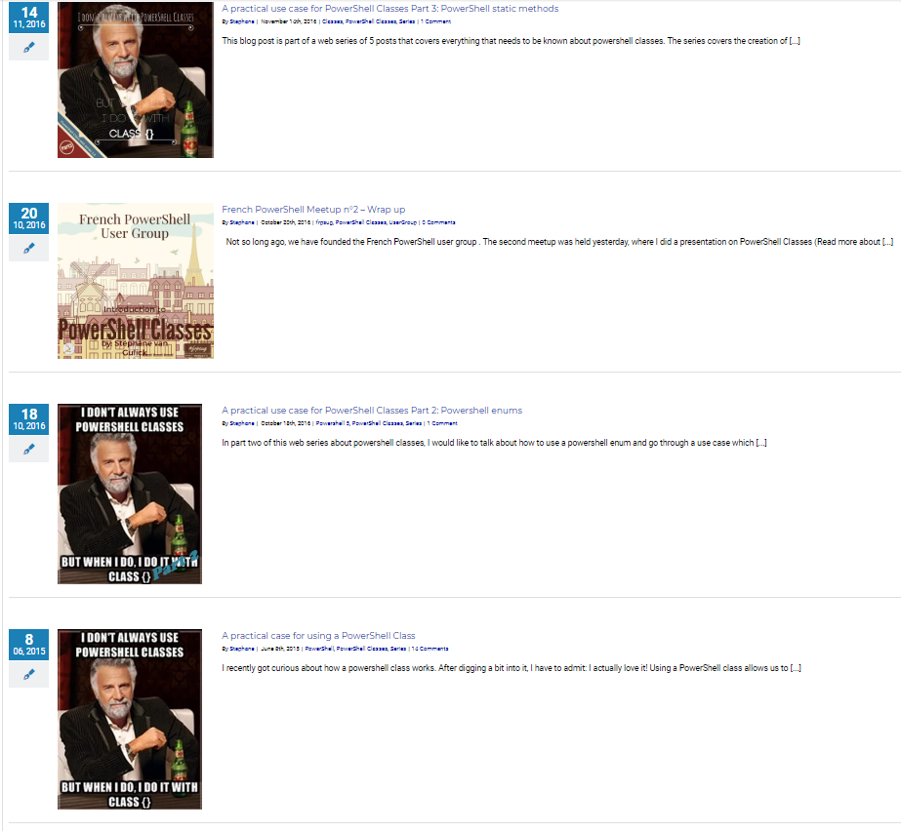
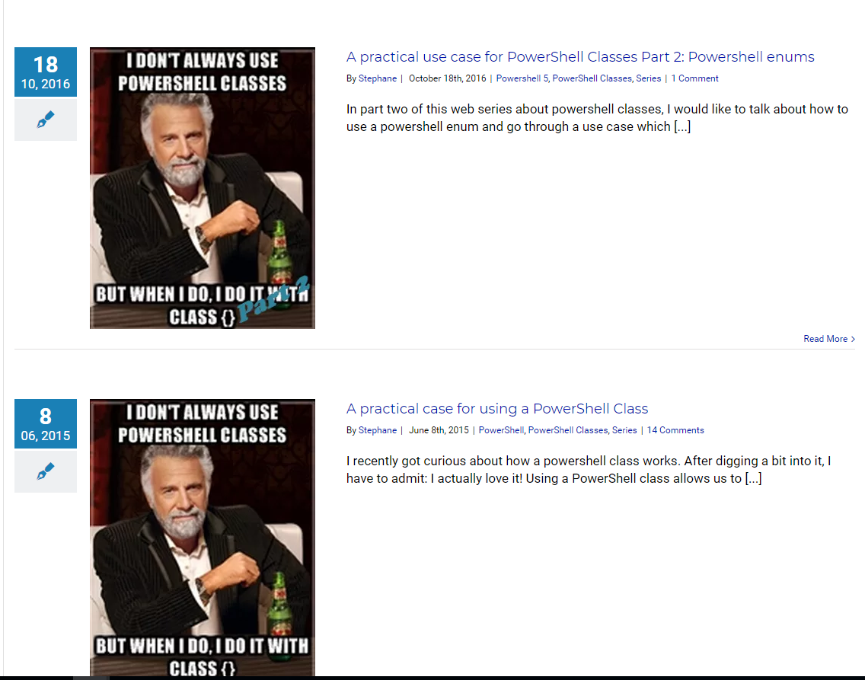


Slide 19
$False

Slide 20
Session plan
Learning what an object was
Learning OOP basics
Reusing knowledge
Looking forward
Making mistakes

Slide 21
OOP concepts
Programming Guidelines
Notes:
Please invest some time to reconsider your session: what is it that audience can get out of it? Try and be as precise as you can. If you are showing solutions, then focus on “how to”. If you present about a general technology, you’ll want to stick to “Be able to” or “Understand why/how”.

Slide 22

OOP: What's that?
Object Oriented Programming

Slide 23
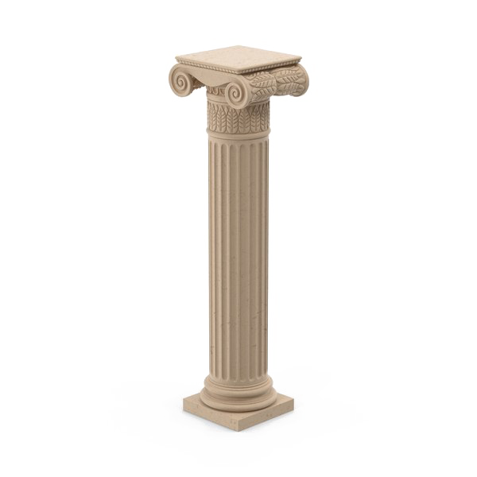
4 pillars of OOP
Abstraction
Encapsulation
Inheritance
Polymorphism

Slide 24
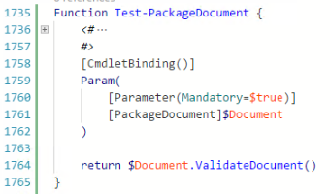

4 Pillars of OOP: Abstraction

Slide 25
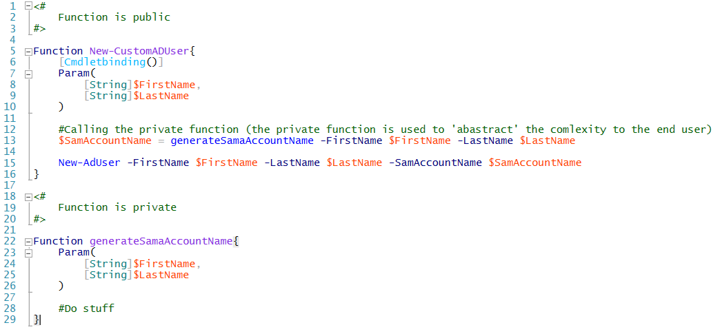
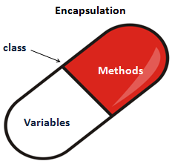
4 Pillars of OOP: encapsulation
encapsulation

Slide 26
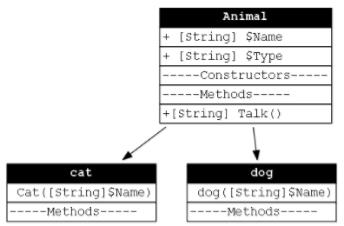
inheritance

Slide 27

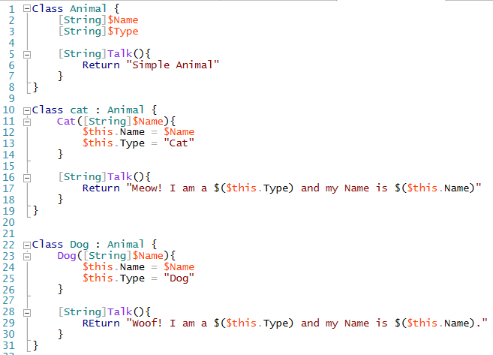
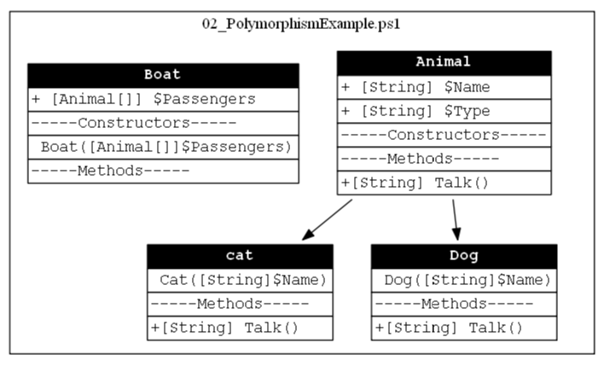
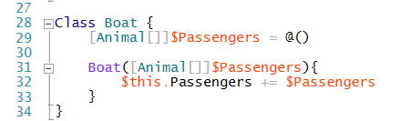
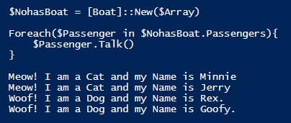
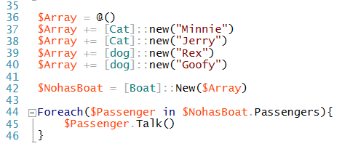
4 Pillars of OOP: polymorphism
???
polymorphism
15 Septembre 2018 - #FrPwshSat2018

Slide 28
Open source projects using Powershell Classes
My own projects and (really cool) projects existing in the field

Slide 29
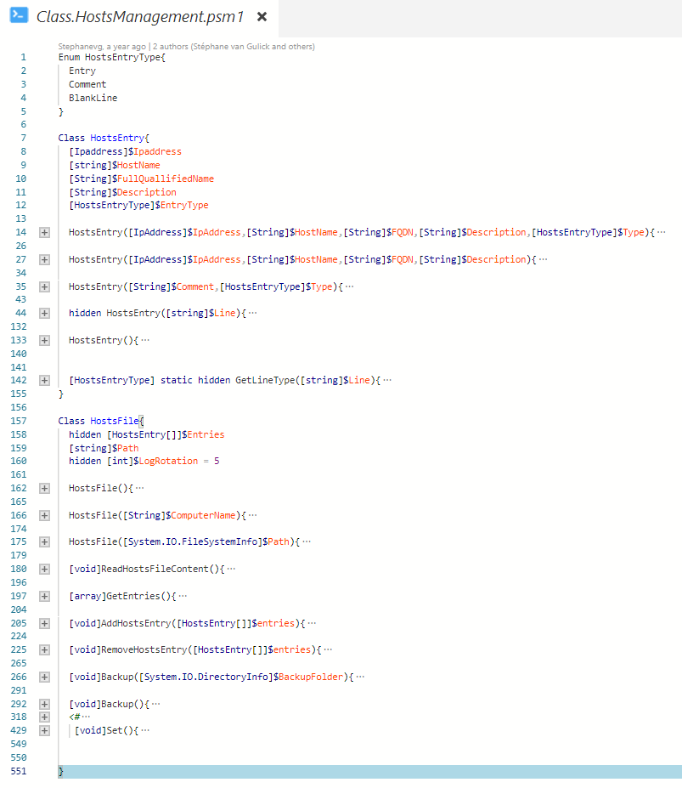

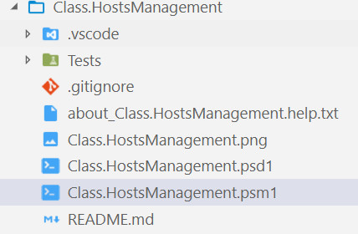
Class.HostsManagement: (me)
Simple classes + Enum -> https://github.com/Stephanevg/Class.HostsManagement
Notes:
2 classes and one enum in one single PSM1 file.
No functions. The User needs to create the intances and call the different methods them self.
Draw back → Documentation

Slide 30
Feedback
How does it work?
How do I load the module?
How can I do $Something
Where is the help? (get-Help?)

Slide 31
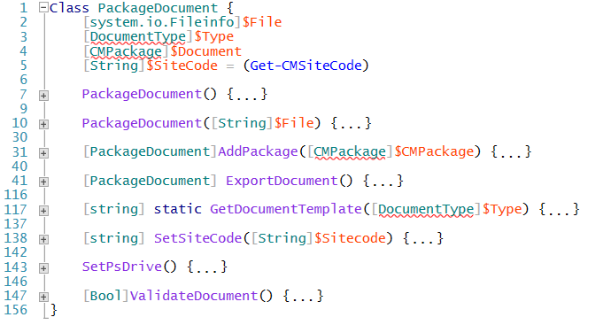
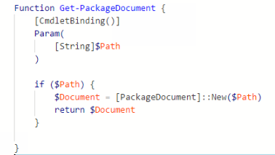
Learnings: Module Structure using classes
MODULE
Class
Functions
Base functionality
Exposes functionality

Slide 32
Benefits of this approach
Possibility to use Comment based help
Expose only the functionality that the end user needs to have access to (Abastraction)
Simplifies the development process
Classes will work like an API (kind of…)
Backend code (classes) can be updated without impacting front end code (Eases refactoring)
Facilitates the Testing process
Facilitates how users import the module

Slide 33
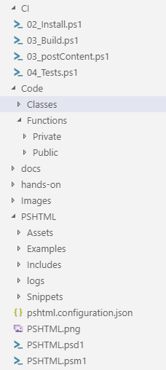
Learnings: File structure
Organize classes and functions in separate folders
Differentiate public from private functions
One File per class or one file per domain
Publish (and test) the code in one single psm1 file respecting the following order: Enums, classes, private functions, public functions.

Slide 34
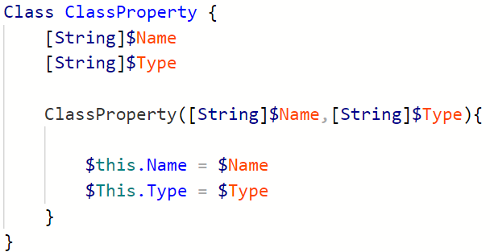
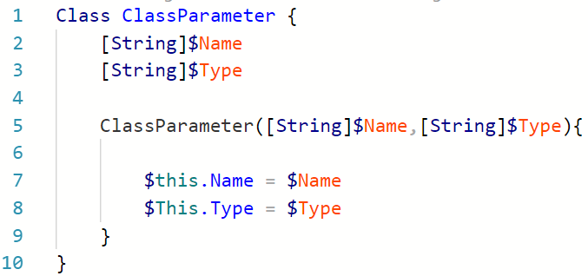
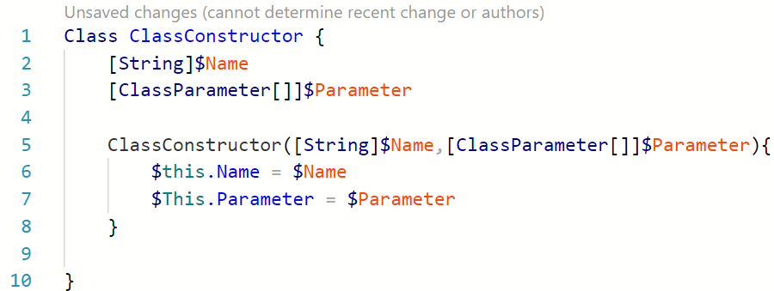
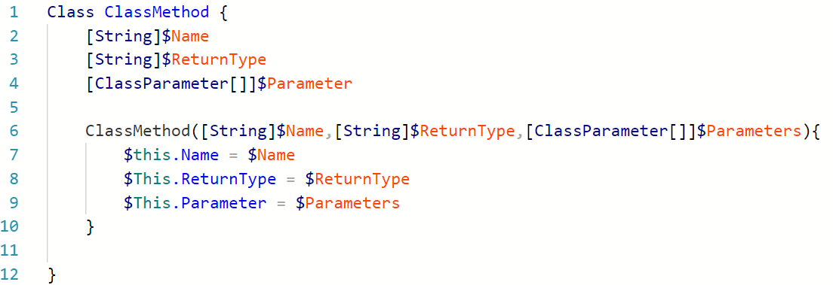
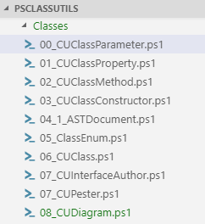
PsClassUtils – Stéphane van Gulick (me)

Slide 35
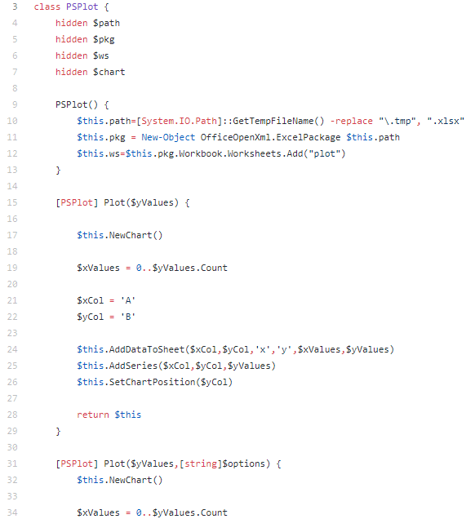
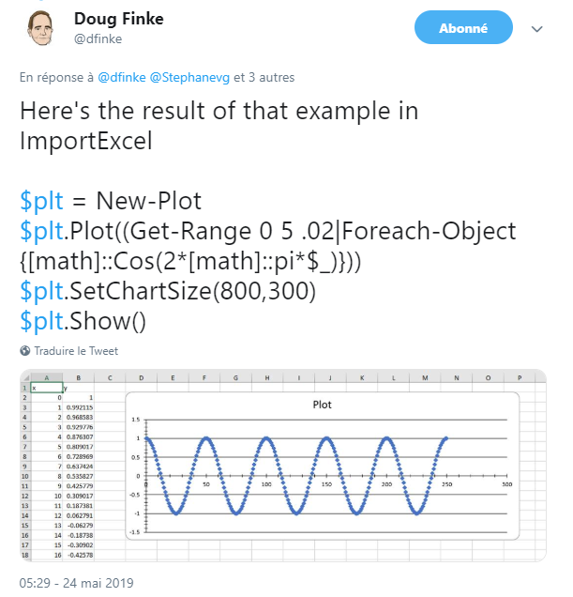
ImportExcel – Doug Finke
https://github.com/dfinke/ImportExcel/blob/master/plot.ps1

Slide 36
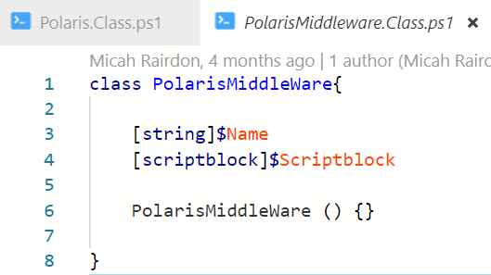
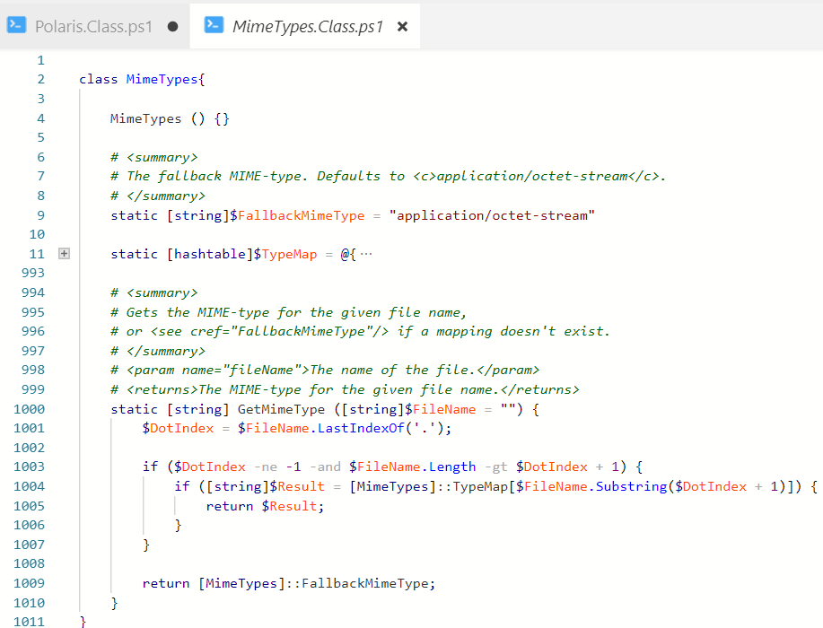
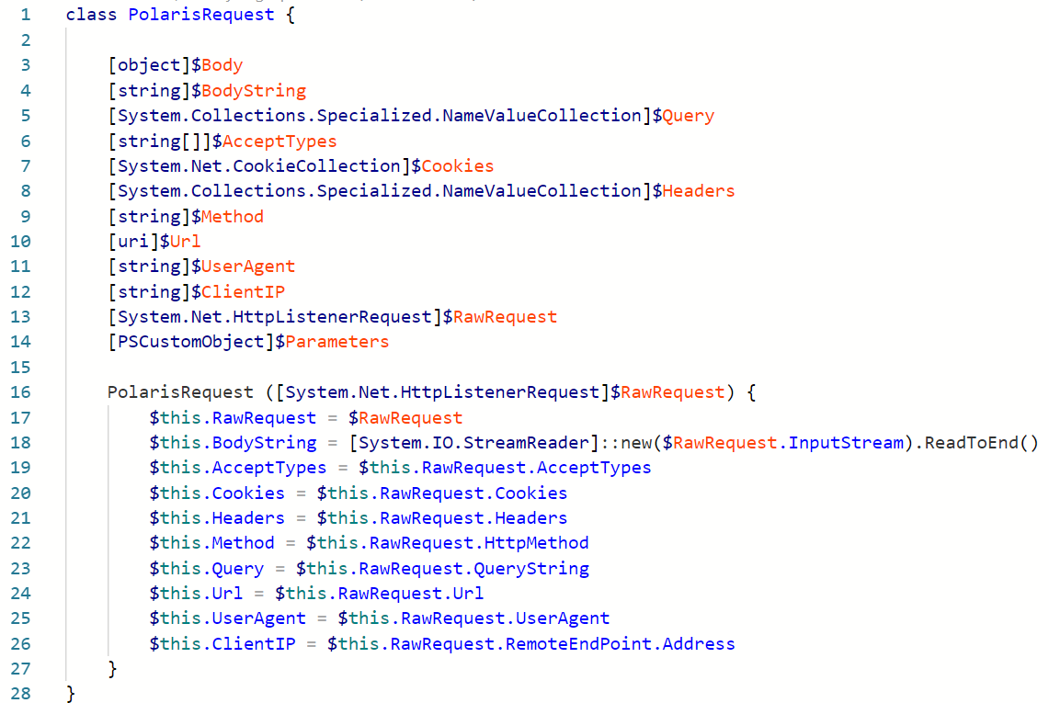
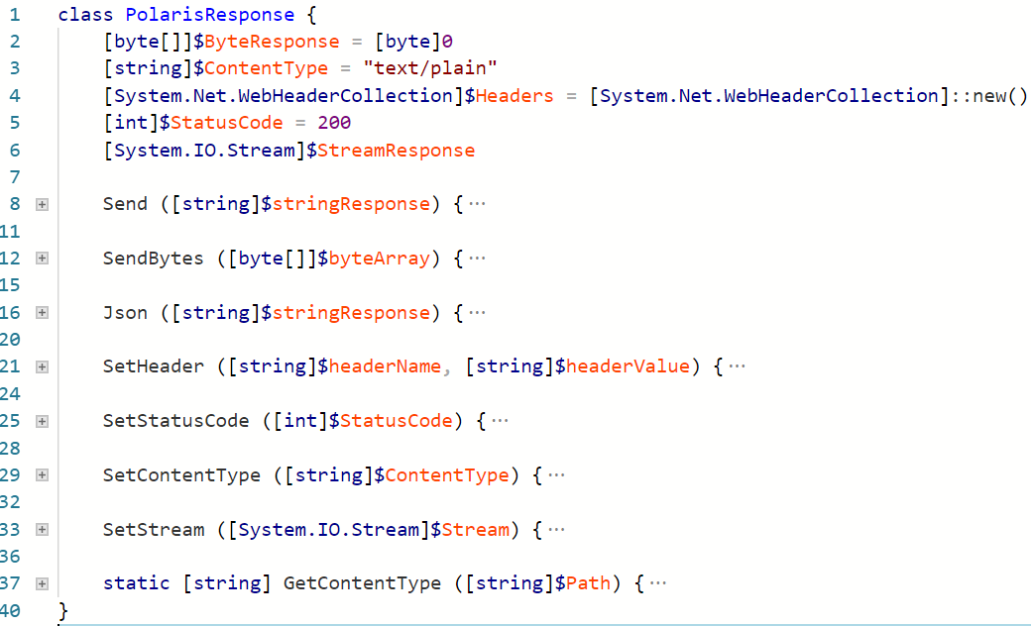
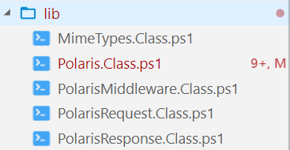
Polaris – Tyler Leonhardt / Micah Rairdon
https://github.com/PowerShell/Polaris - (5 'big' classes)

Slide 37
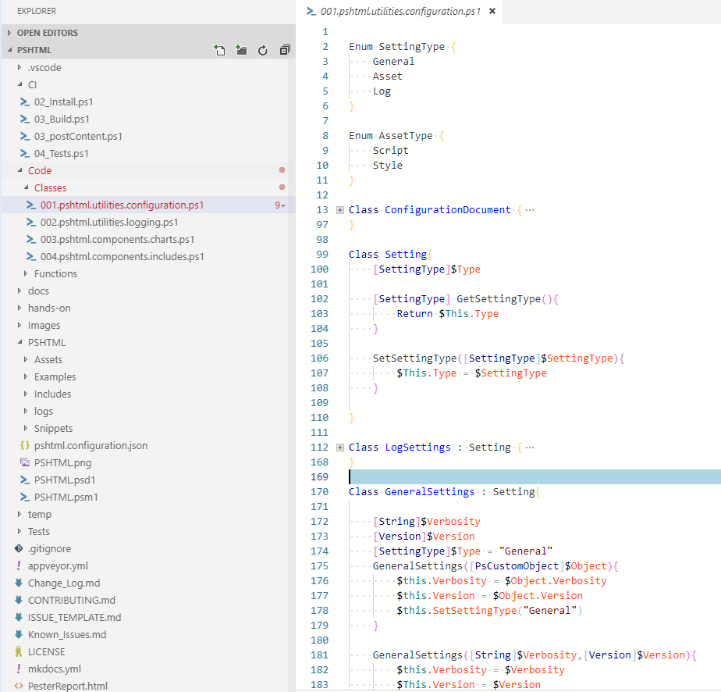
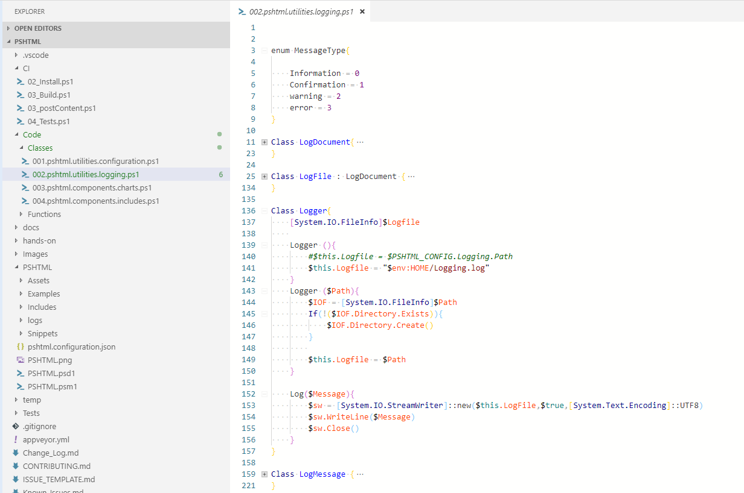
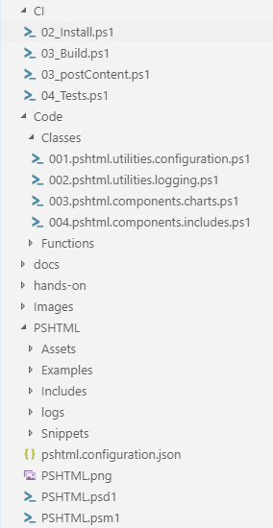
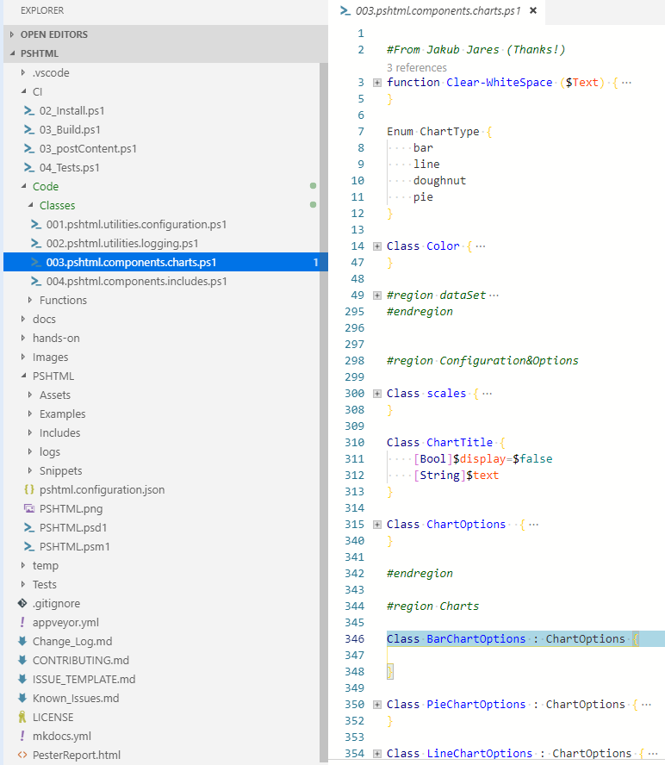
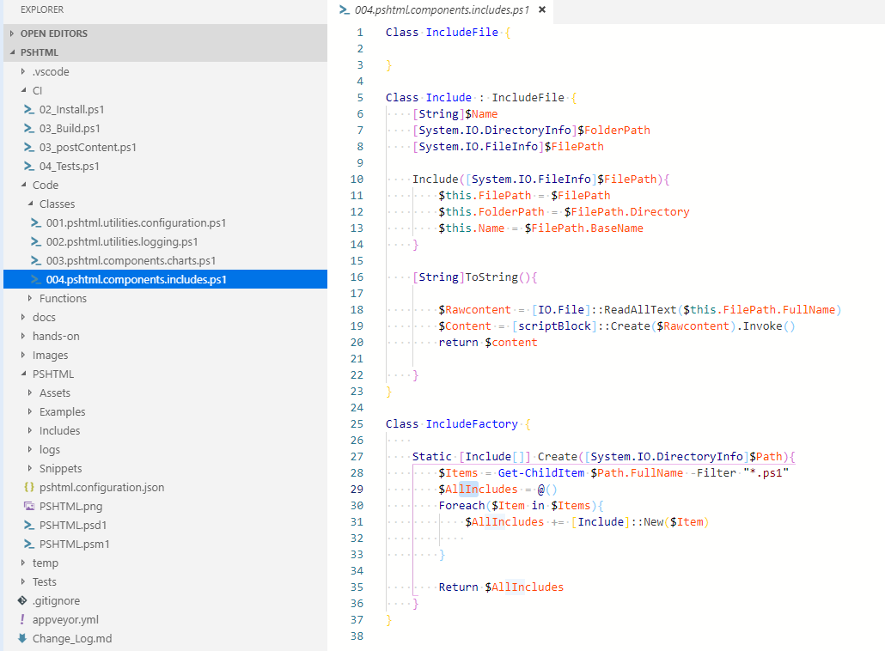
PSHTML – Stéphane van Gulick (me)
37 Classes

Slide 38
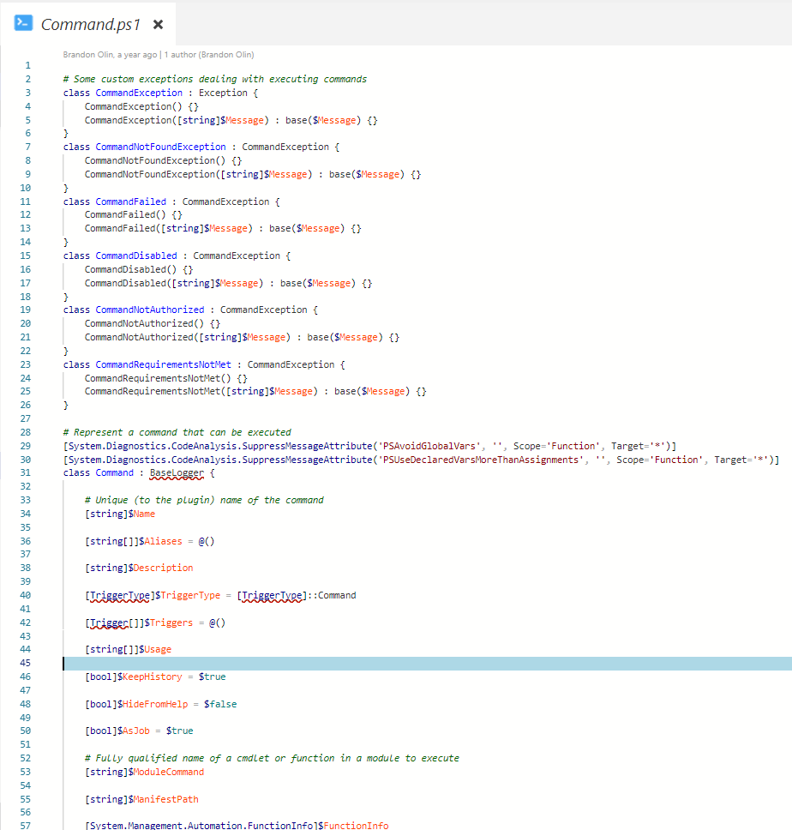
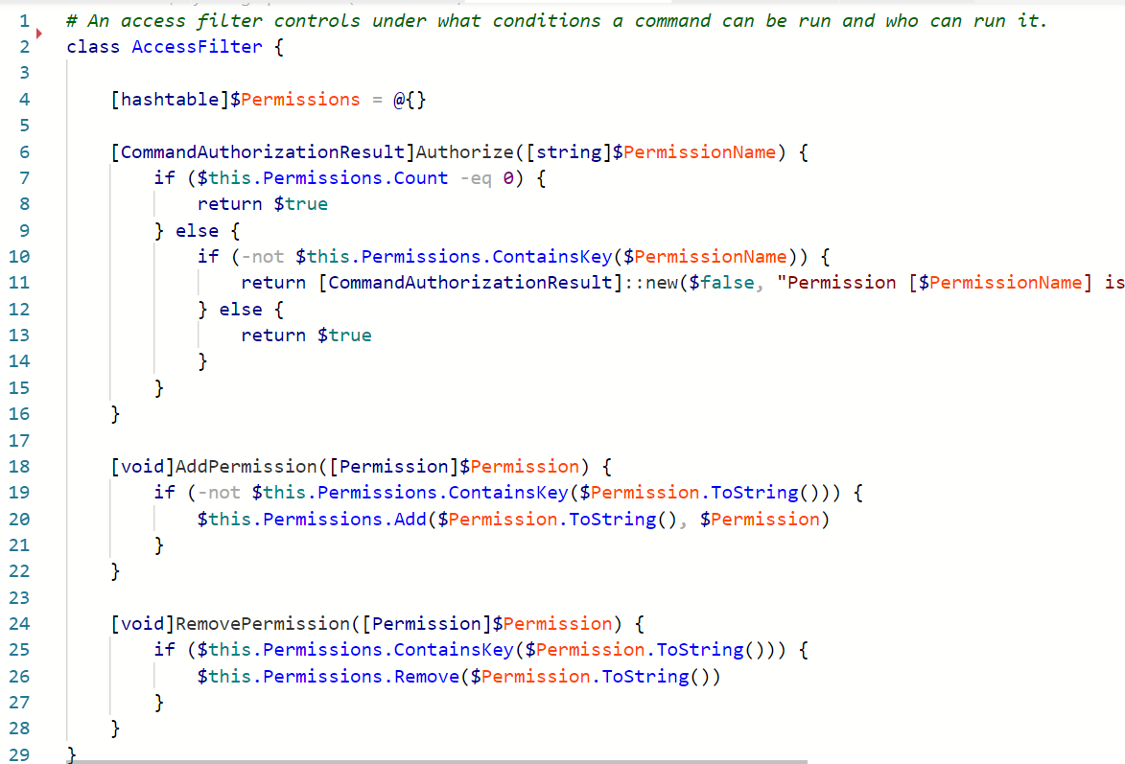
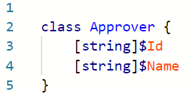
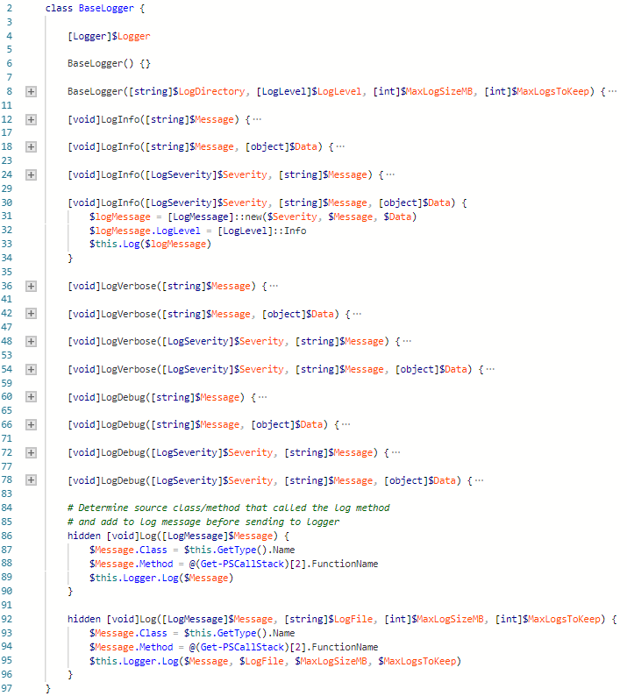
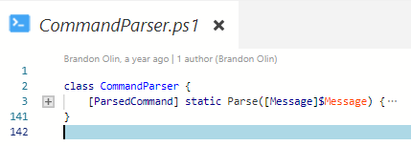
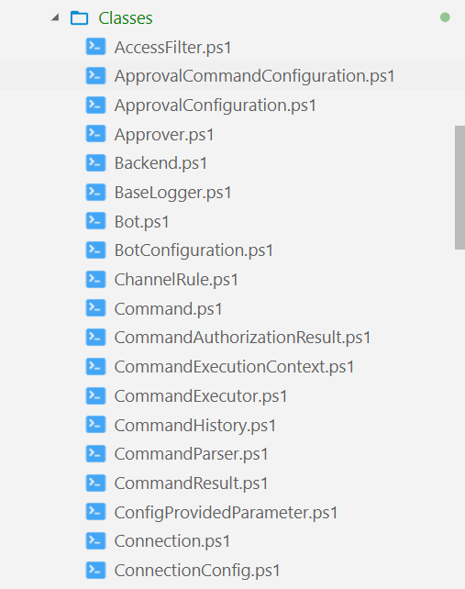
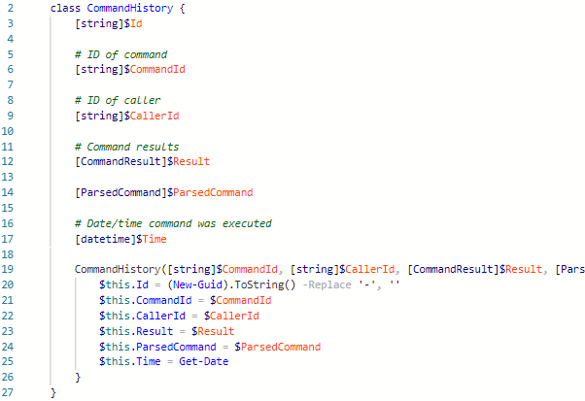
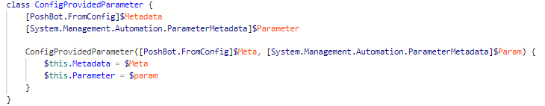
PoshBot – Brandon Olin
https://github.com/poshbotio/PoshBot
43 Classes!

Slide 39
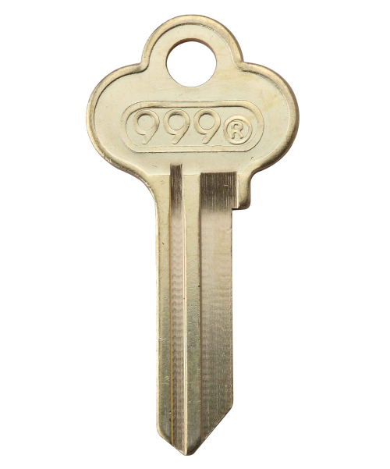
My key take aways
File structure is key
Write core functionality in classes
Expose end user functionality through functions
Use single PSM1 file

Slide 40
Session plan
Learning what an object was
Learning OOP basics
Reusing knowledge
Looking forward
Making mistakes

Slide 41
Communicate via diagrams: UML
A picture is worth a thousand words

Slide 42

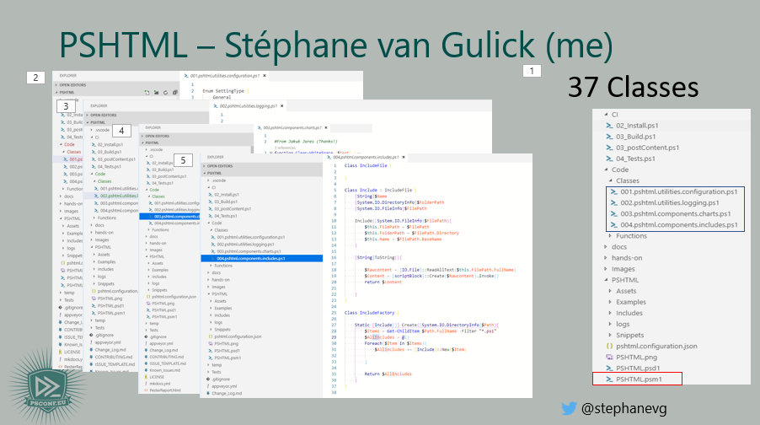
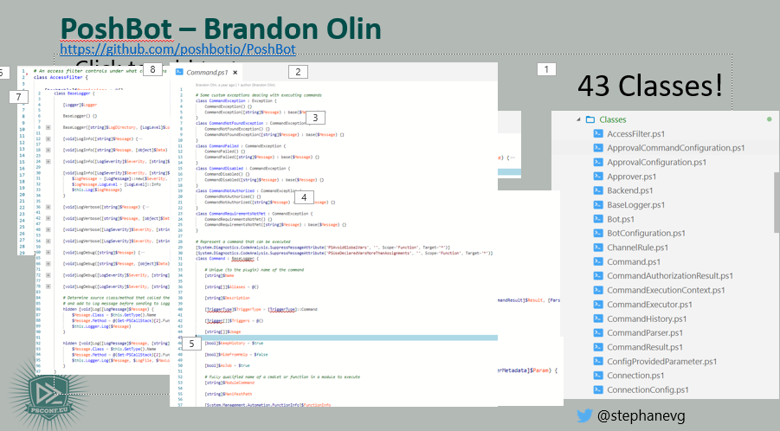
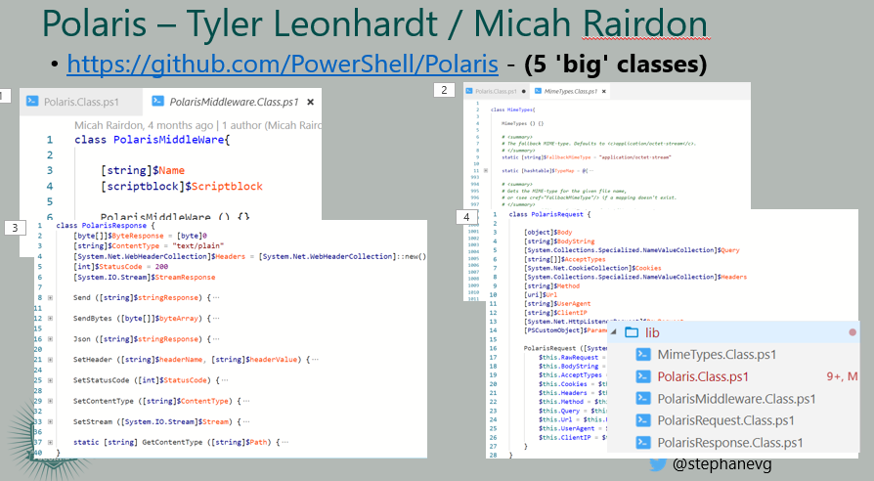

Communicate via images using UML Diagrams

Slide 43

Communicate via images using UML diagrams

Slide 44
PSClassUtils
Notes:
Write-CUClassDiagram -Path C:\Users\taavast3\OneDrive\Repo\Projects\OpenSource\PSHTML\PSHTML\PSHTML.psm1 -Show

Slide 45
Demo recap:
Find-Module PsClassUtils | Install-Module
Import-Module PsClassUtils
Write-CUClassDiagram -Path $PathToPsm1 -Show

Slide 46



Polaris

Slide 47




Poshbot

Slide 48
Session plan
Learning what an object was
Learning OOP basics
Reusing knowledge
Looking forward
Making mistakes

Slide 49
Chill:

Slide 50
Use well known standards:
SOLID

Slide 51

Use well known standards:
Robert C. Martin (Aka – Uncle Bob)
S
O
L
I
D

Slide 52
Use well known standards:
Single responsibility principle
One class / method must have
only one responsibility
S
O
L
I
D

Slide 53
Use well known standards:
Open Closed Principle
Open for extension
But
Closed for modification
S
O
L
I
D

Slide 54
Use well known standards:
Ability to replace any instance of a parent class with an instance of one of its child classes without side effects
S
O
L
I
D
Liskov substitution principle

Slide 55
Use well known standards:
S
O
L
I
D
Write a lot of small interfaces instead of one huge interface
A class should not be forced to depend on methods it doesn't use
Interface segragation principle

Slide 56
Use well known standards:
High level Modules should not depend on low level implementations
S
O
L
I
D
The ActiveDirectory Module should depend on your script to work.
The ActiveDirectory Module should not depend on your script
Dependency inversion principle

Slide 57

Use well known standards
Single responsibility principle
Open Closed principle
S
O
L
I
D
Liskov Substitution principle
Interface segragation principle
Dependency inversion principle

Slide 58
TDD
Test driven developement

Slide 59
Test driven developement
You are NOT allowed to write production code that DOESN'T has a test.
Write a test, and make it fail
1
2
3
Write ONLY enough production code to make the test pass.
Write a test, and make it fail

Slide 60
Automatically generate pester tests

Slide 61
Demo recap
Find-Module PsClassUtils | Install-Module
Import-Module PsClassUtils
Write-CUPesterTest -Path $PathToClassFile

Slide 62
Reusing existing knowledge: Design patterns

Slide 63


Design patterns

Slide 64

Design pattern: example
State Pattern

Slide 65

Design pattern: example
State Pattern

Slide 66





Design pattern: example
State Pattern

Slide 67


Design pattern: example
State Pattern

Slide 68
Design pattern: example
State Pattern

Slide 69
Design pattern: Key take aways
State Pattern
Used different classes to express the notion of 'State'
Each class is (represents) a specific state, with it's own behaviour
Used inheritence
Used Polymorphism
State Pattern
Standard Answer to a common / Well known problem
Reusable design
Reusable Code

Slide 70



Design pattern: Key take aways

Slide 71

Design pattern: Key take aways
State Pattern
State Pattern

Slide 72
Session plan
Learning what an object was
Learning OOP basics
Reusing knowledge
Looking forward
Making mistakes

Slide 73


Design patterns

Slide 74
Design patterns
Creation Design Patterns
Singleton Pattern
Factory Pattern
Abstract factory
Builder Pattern
Prototype Pattern
Structural Design Patterns
Adapter Pattern
Composite Pattern
Proxy Pattern
Flyweight Pattern
Facade Pattern
Bridge Pattern
Decorator Pattern
Behavioral Design Patterns
State Pattern
Observer Pattern
Strategy Pattern
Iterator Pattern
Visitor Pattern
Template Method
Mediator Pattern
Command Pattern
Interpreter Pattern
Memento Pattern
Chain of responbility pattern

Slide 75

What doe you see?

Slide 77
# Follow these instructions to show perfectly color-coded PowerShell code.
# Paste code to PowerShell ISE, select it, and copy it to the clipboard.
Paste-Code -ToISE | Select-Code | Copy-ToClipboard
# To insert it with full color-coding, paste the code into your slide.
# It will be black, and there is a toolbutton labelled (Ctrl) in PPT.
Click-ToolButton -Choose SymbolWithClipboardAndBrush
# Click the toolbutton, and choose the button that shows a clipboard with a brush.
# This will add color-coding back to the pasted code
PLEASE NOTE: You do not need to use PowerShell ISE to code, or to demo.
Use your preferred editor. With a light theme.
These steps use PowerShell ISE to color-code your code correctly and consistently, and insert the color-coded code into the slide. Please help make all code look consistent. Many thanks!
This is an example of the “Code” layout.
Notes:
To color-code PowerShell code in a consistent way, we ask that you paste your code into PowerShell ISE, select it, and copy it from ISE. Next, paste the code into the text field. It will appear black at first. When you click the small tool button that appears after pasting the code, choose the middle icon with the brush. This adds back the token colors.
Again, use any editor you want during your demos. We ask that you use ISE solely for the purpose of consistently color-coding.
If you use editors other than ISE, make sure you choose a light theme. Dark themes are hard to watch in a presentation room.

Slide 78
Summary
Make sure you add a summary slide
Use 3-5 bullet points to reiterate key points
This is an example of the “Title and Content” layout.
Notes:
Sum up your key messages

Slide 79
Notes:
[REQUIRED SLIDE]
Make sure you provide all materials that audience needs to reproduce your demos.
Either upload them as a PowerShell module to www.powershellgallery.com (preferred for reusable functions)
Or, upload them to our github repository (ask the girls at the info desk to provide you with access)
Or, upload them to your own github repository
Please make sure all materials are available by the time your presentation starts, or at minimum upload them right after your presentation

Slide 80
Notes:
[REQUIRED SLIDE]
If you sticked to your timing, you now have 15 min left for Q&A. If you missed your timing, you will have to leave the room when your slot is over. In this case, invite your audience to the coffee break and offer to cover questions there.
IN ANY CASE please point your audience to the conference app and the session voting. By the time the conference opens, the eventraft app *should* have the option to vote on sessions.
Please MAKE SURE you leave your room when your slot is over. The next speaker would like to set him/herself up and get everything up and running.

